Slide 1

QUIZZLET
Quizzlet is an interactive quizzing application that facilitates teachers and students to create customized comprehensive quizzes that can be used for enriching the learning experience of children. The program allows the user to create a quiz with multiple choice, true/false or short answer questions. Quizzes are stored in a database so they can be accessed at any time.
Java (GUI), MySQL, Swing, AWT Libraries and Access

Slide 2
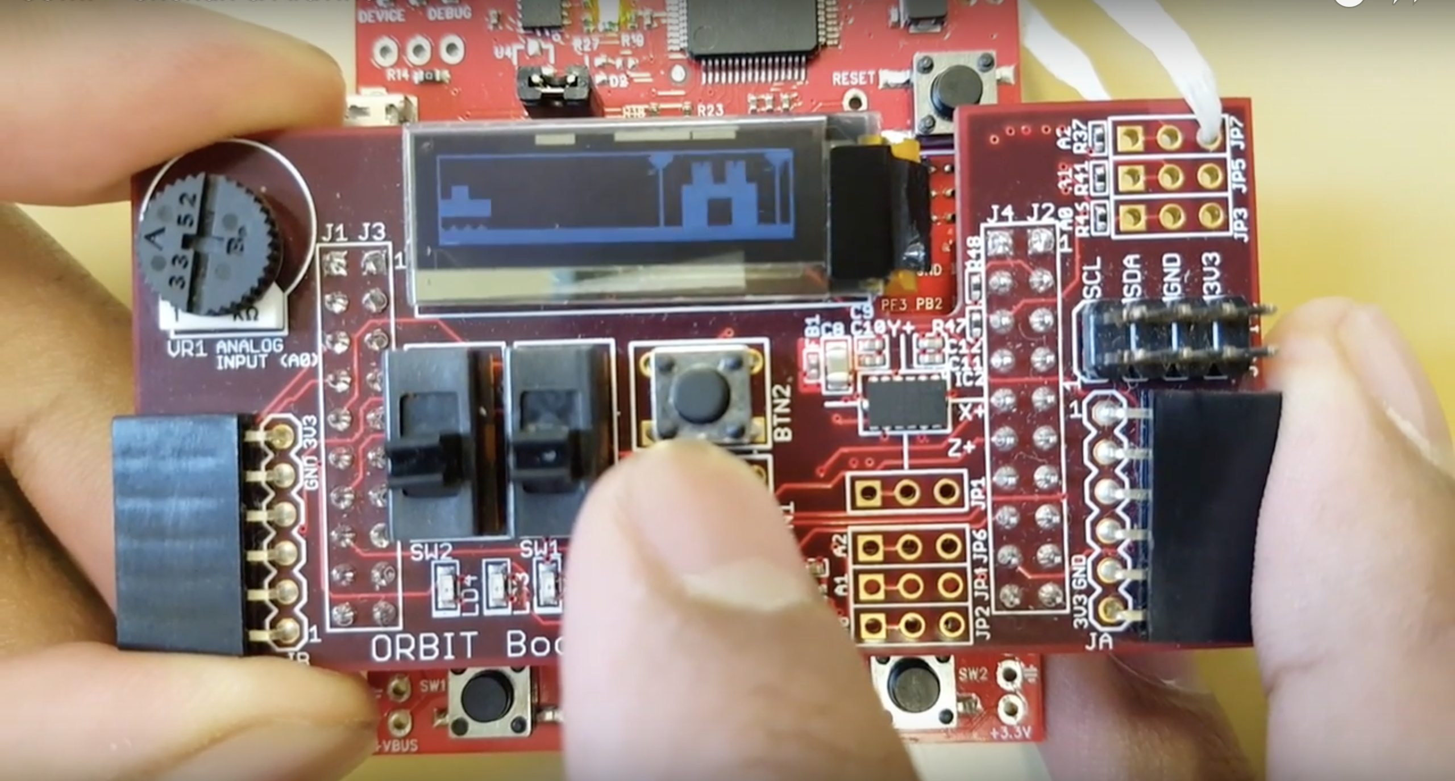
JUMP
JUMP is a multi-level game where the user dodges randomly generated obstacles in order to reach the end. Utilizes an Orbit Booster Pack to display graphics on the LED Screen and uses buttons, accelerometer and potentiometer for in-game control.
C, C++, Tiva-C Arduino Board

Slide 3
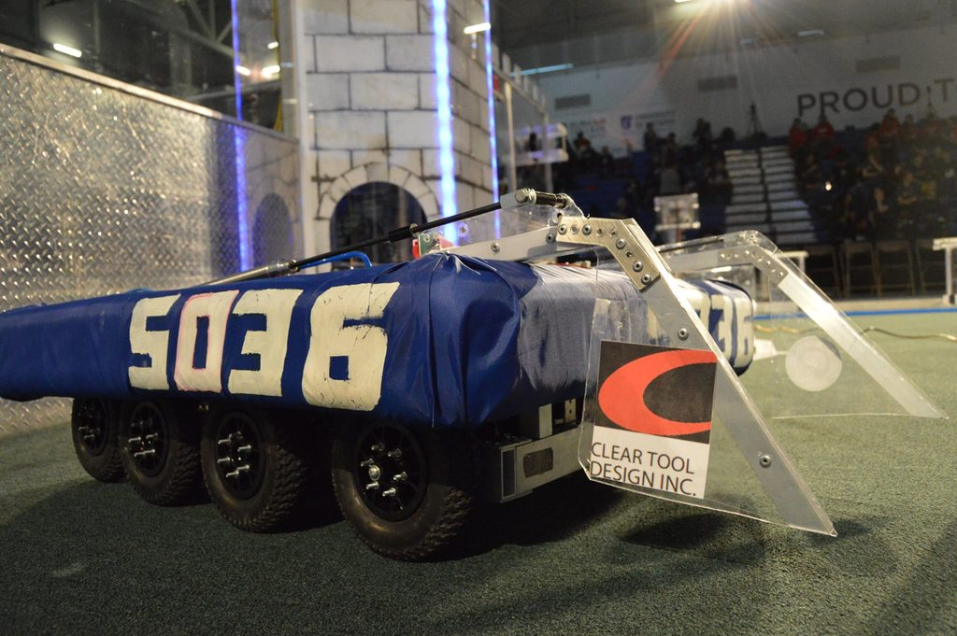
Robot Code
Code that I have written for FRC and VEX Competitions. This includes code for both tele-operated control and autonomous procedures. Several optimizations have been made to the code in order to complete the required task in as little time as possible.
RobotC, Python and Java

